Slide 1
Altering display with pipes and styles
Spencer Schneidenbach

Slide 2
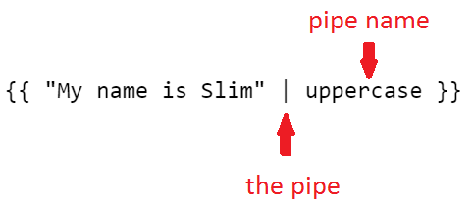
Pipes
Filters in Angular 1
Alters the display of an interpolated expression

Slide 3
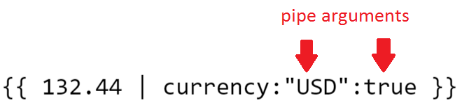
Pipes, cont’d
Pipes can take arguments/parameters
Parameters are expressions like everything else
Separated by colons :

Slide 4
Some built-in pipes
number
currency
percent
json
uppercase/lowercase
async
But that’s another show
Demo

Slide 5
Pipes no longer
A few filters didn’t make it over from Angular 1
orderBy and filter
Why?
Performance
Separation of concerns

Slide 6
Styling
Lots of different things to choose from!

Slide 7
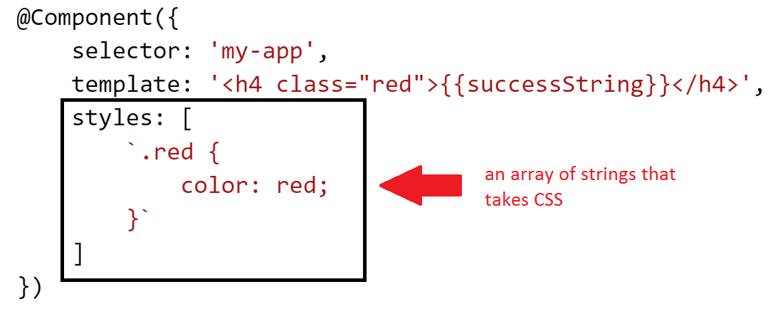
Styles directly on component
You can add CSS directly to a component! Demo

Slide 8
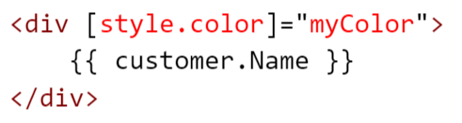
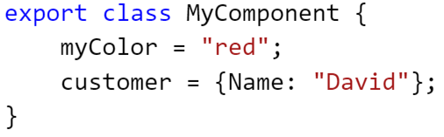
You already saw property bound styles
But in case you forgot

Slide 9
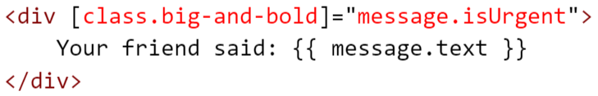
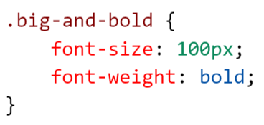
How about property-bound CSS classes?
Bind CSS classes to an element like this
If message.isUrgent is truthy, then the big-and-bold CSS class will be applied to the element

Slide 10
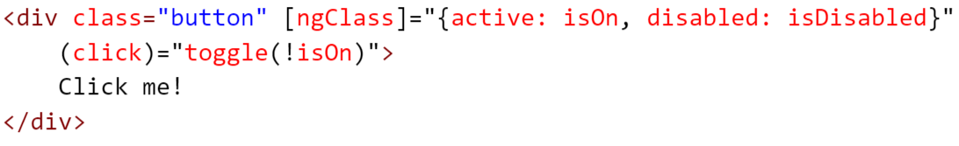
ngStyle and ngClass
You can also apply multiple styles/classes to an element in one shot – using ngStyle - Demo
Same thing with ngClass - Demo

